Slide 1

Python Final Project MIS 6382.502 Group 11
Section: 6382.502
Group 11
Group Members:
Ameya Naik
Chinmyee Gurav
Gauri Binoy
Shashank Marri
Mentor: Prof. Rabih Neouchi

Slide 2
Introduction to Data: Exploring Library Book Data
Key Features of the Dataset:
This dataset provides a comprehensive view of books in a library catalog, capturing details like genre, type, customer ratings, and average reading time. The goal is to analyze trends, understand customer preferences, and identify patterns in pricing and reading habits.
We are comparing data of over 10,000 books in a library, featuring 9 unique titles across 3 genres, with the dataset spanning a period of 1 year.
Unique ID
Date Added
Title
Genre
Type
Rating
Average Reading Time
Price

Slide 3
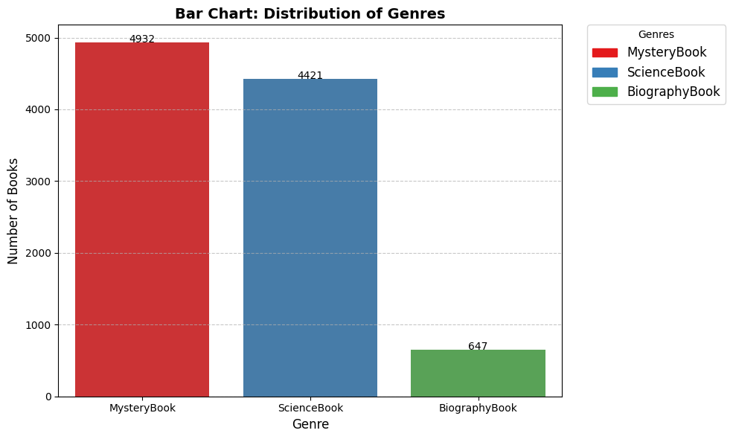
Bar Chart: Genre Distribution
Key Insights:
1. Genre Popularity: MysteryBook and ScienceBook are the most prevalent genres in the collection, with 4,932 and 4,421 books respectively, highlighting a strong focus on these categories.
2. Underrepresented Genre: BiographyBook is significantly underrepresented, with only 647 books, indicating an opportunity to expand the library’s offerings in this genre.

Slide 4
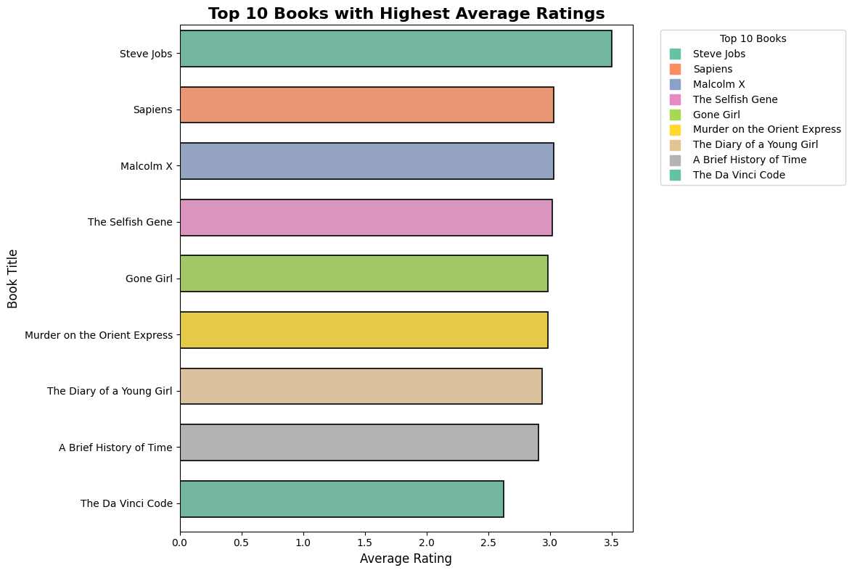
Bar Chart: Top 10 Books with Highest Average Ratings
Key Insights:
1. Top-Rated Book: Steve Jobs stands out as the highest-rated book, with an average rating exceeding 3.5, reflecting its exceptional popularity and positive reception.
2. Consistent High Ratings: The remaining top-rated books, such as Sapiens, Malcolm X, and The Selfish Gene, have ratings slightly above 3.0, indicating consistent high-quality feedback across a diverse mix of genres, including biographies, science, and fiction.

Slide 5
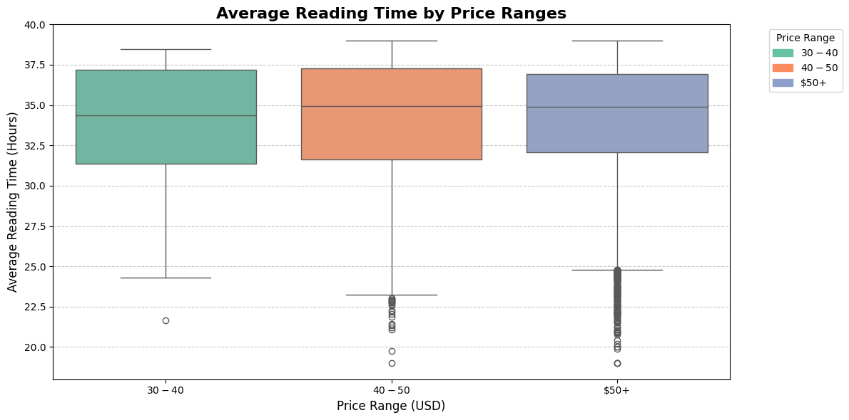
BOX Plot: Average Reading Time by Price Ranges
Key Insights:
1. Mid-Range Stability: Books priced between $30–$50 have consistent engagement, with median reading times around 33–35 hours.
2. High Variability: Books priced above $50 show greater variability in reading times, with some outliers indicating lower engagement.

Slide 6
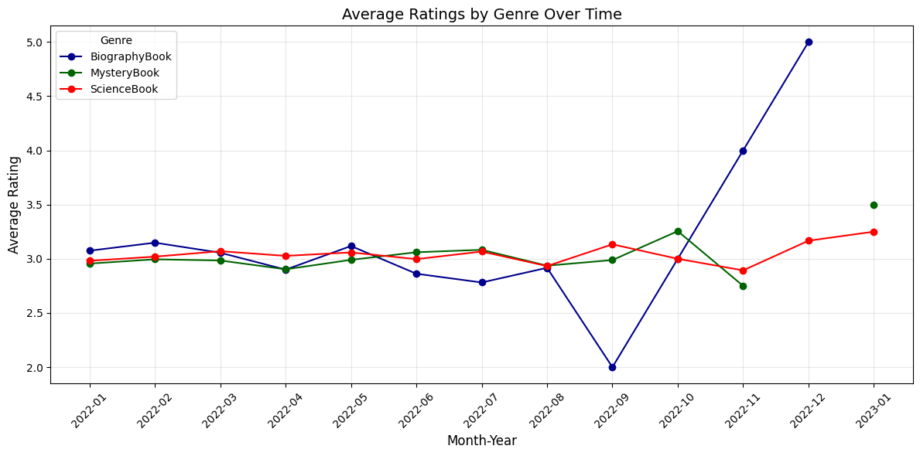
Line Plot: Average Ratings by Genre Over Time
Key Insights:
1. Consistent Ratings: BiographyBook and ScienceBook maintain steady average ratings around 3.0–3.5, indicating consistent reader satisfaction over time.
2. Notable Spike: BiographyBook experiences a significant spike in November 2022, with an average rating exceeding 4.5, highlighting a surge in positive feedback or highly-rated additions.

Slide 7
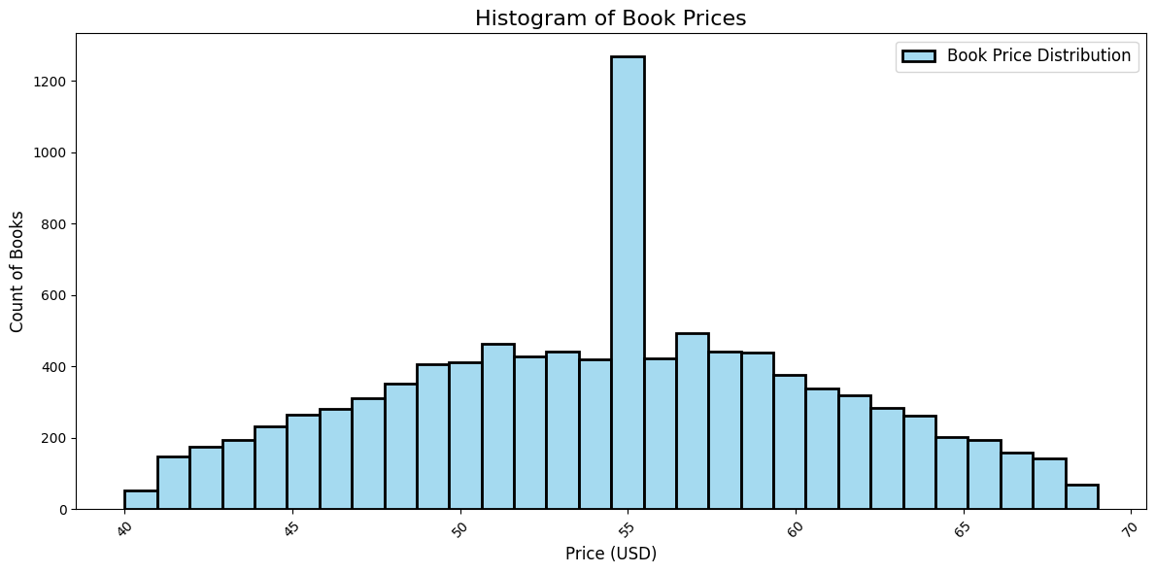
Histogram: Book Prices
Key Insights:
1. Dominant Price Point: The price range around $55 has the highest concentration of books, indicating it is the most common pricing point in the library’s collection.
2. Symmetrical Distribution: The book prices form a near-symmetrical distribution centered around $55, with a gradual decline in the number of books as prices move toward the lower and higher ends.

Slide 8
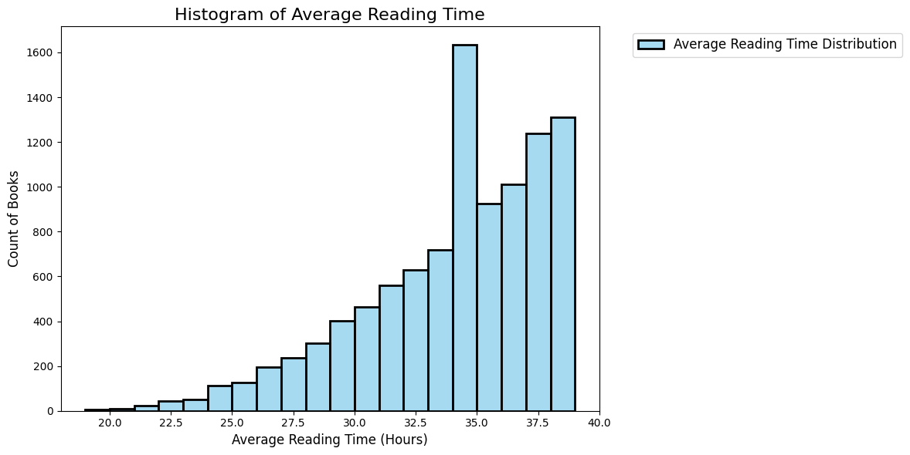
Histogram: Average Reading time
Key Insights:
1. Dominant Reading Time Range: Books with an average reading time between 35 and 37.5 hours dominate the distribution, indicating that most readers prefer books that require moderate to long reading time.
2. Gradual Increase in Reading Time Preference: The distribution shows a steady increase in the number of books as the average reading time progresses from 20 to 35 hours, reflecting a growing preference for longer reading durations among the library’s offerings.

Slide 9
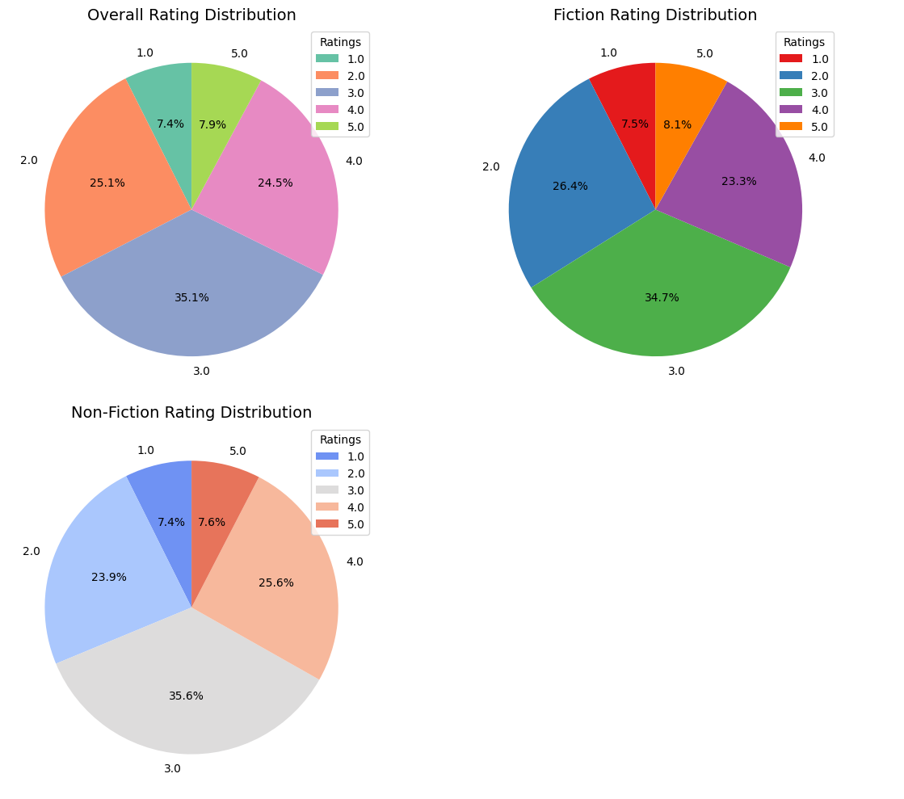
Pie Chart: Overall, Fiction and Non-fiction distribution
Key Insights:
1. Dominance of 3-Star Ratings: Across all three distributions (Overall, Fiction, and Non-Fiction), 3-star ratings are the most common, accounting for 35.1% of overall ratings, 34.7% for Fiction, and 35.6% for Non-Fiction. This consistency highlights a general trend of moderate satisfaction among readers.
2. Fiction’s Slight Edge in 5-Star Ratings: Fiction books have a slightly higher proportion of 5-star ratings (8.1%) compared to Non-Fiction (7.6%). This indicates that Fiction books are marginally more likely to receive top ratings, reflecting their popularity and strong reception.
3. Balanced Rating Distribution: Both Fiction and Non-Fiction books show a relatively balanced spread of ratings across all categories, with minimal differences in low (1-star) and high (5-star) ratings, suggesting consistent quality and reader satisfaction across genres.

Slide 10
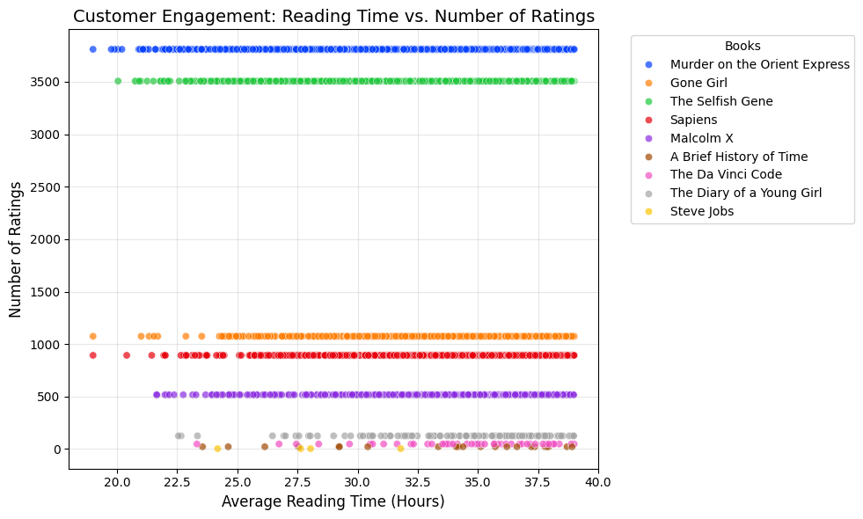
Scatter PloT: Reading Time Vs Number of Ratings
Key Insights:
1. High Ratings for “Murder on the Orient Express” and “The Selfish Gene”: These books stand out with the highest number of ratings, indicating their popularity and strong engagement among readers.
2. Wide Variation in Reading Times: Books such as “Gone Girl” and “Sapiens” show a broad range of average reading times, suggesting diverse reader engagement levels and preferences depending on book complexity and genre.

Slide 11
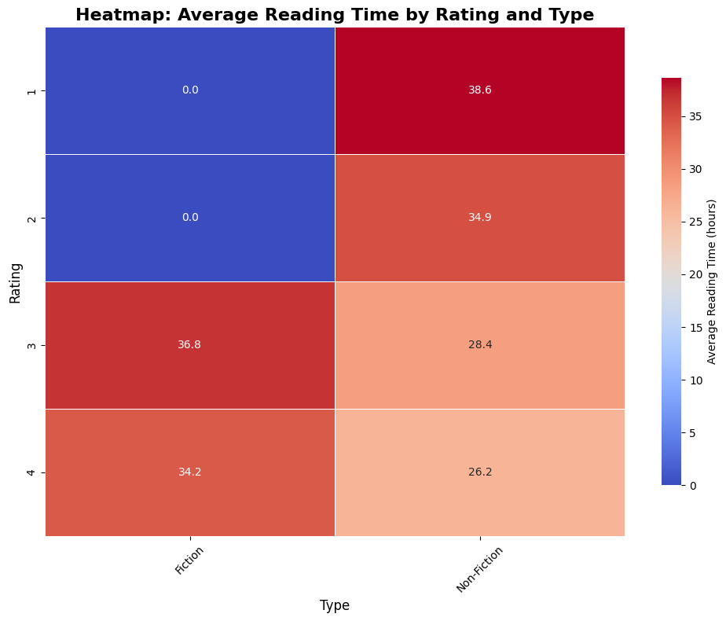
Heat Map: Average Reading time by Rating Type
Key Insights:
1. Fiction Books Show Higher Reading Time: Fiction books consistently have higher average reading times compared to Non-Fiction across ratings, with a notable peak at a rating of 3, averaging 36.8 hours.
2. Non-Fiction Books Have Lower Engagement: Non-Fiction books display lower average reading times overall, particularly at ratings of 3 and 4, where the average reading times are 28.4 and 26.2 hours, respectively, indicating lesser engagement compared to Fiction.

Slide 12
Conclusion
The dataset provides a well-rounded view of the library’s collection, shedding light on patterns in book pricing, genre preferences, ratings, and reader engagement.
Dominant Genres: Fiction and Science books dominate the collection, indicating strong reader interest in imaginative and knowledge-driven content. The limited presence of Biography books highlights an opportunity for expansion in this genre.
Pricing Structure: The majority of books are priced within a balanced mid-range ($45–$65), ensuring accessibility and affordability for a wide range of readers.
Reader Engagement: Engagement varies across genres and price ranges:
Mid-priced books show consistent engagement.
Higher-priced books display greater variability in reading times, reflecting differing levels of reader commitment.
Ratings Patterns: Ratings are consistently high across genres, suggesting uniform quality within the collection. Fiction books, however, exhibit a slightly higher proportion of perfect ratings, underscoring their popularity and positive reception.
Overall Insights: The dataset reflects a well-curated library collection with opportunities for improvement:
Increase genre diversity, especially for Biography books.
Address gaps in quick-read options to cater to varied reader preferences.
Maintain focus on quality and accessibility to serve a broad readership effectively.

Slide 13
Recommendation
Diversify Genre Representation: Increase the collection of BiographyBooks to balance genre availability and cater to a broader audience. This can attract readers with interests in real-life stories and historical accounts, addressing the current gap in the library’s offerings.
Enhance Pricing Strategy: Introduce a wider range of books in the lower-priced segment (<$45) to ensure affordability for cost-sensitive readers. Similarly, evaluate the content quality of higher-priced books ($50+) to justify their cost and improve reader engagement.
Expand Quick-Read Options: Add more books with shorter average reading times (<25 hours) to meet the needs of busy readers or those seeking less time-intensive options. This will enhance the library’s appeal to diverse reader preferences.
Improve Data Tracking: Address gaps in data, such as the missing entries for MysteryBooks post-November 2022, by implementing robust tracking systems to ensure consistent updates across all genres and time periods.

Slide 14
Thank YOU!

